Slide 1

Advanced Javascript
18. marts 2018

Slide 2






What is a website?
Notes:
Explain all parts

Slide 3
What is a website?

Slide 4
HTML – HyperText Markup Language
Defines the structure of a webpage
CSS – Cascading Style Sheet
Defines the visual presentation of HTML elements
JS – Javascript
Handles user interaction and dynamic content

Slide 5

ES6 Introduction

Slide 6
A history lesson
1996 – Standardization in ECMA
1997 – ECMA-262 (ECMAScript)
1998 – ECMAScript 2
1999 – ECMAScript 3
2005 – Work started on ECMAScript 4, Microsoft and Yahoo opposed it, ECMAScript 3.1 was the compromise
2009 – Opposing parties meet in Oslo and come to an agreement. ES3.1 is renamed to ES5, which is what we primarily use today.
2015 – ES6 is released. From now on release will be named after the year it is release

Slide 7
JavaScript of today
JavaScript
Mobile Apps
Desktop Apps
Server
Web browser

Slide 8
Pros of JavaScript
Easy syntax
Functions are objects, i.e. easy to work with
Independent from any of the huge organizations and companies
The only native browser language
It has a vast community
A ton of libraries, frameworks and tools

Slide 9
Cons of JavaScript
There are not many clean code practices
Rapid development and change, makes tools, frameworks and libraries obsolete fast
Comparisons between Java-like languages and JavaScript is confusing

Slide 10
Main goals of ES6
Fix major issues with ES5
Backwards compatibility with ES5
Modernized syntax
Well suited for larger applications
Extended feature set in the standard library

Slide 11
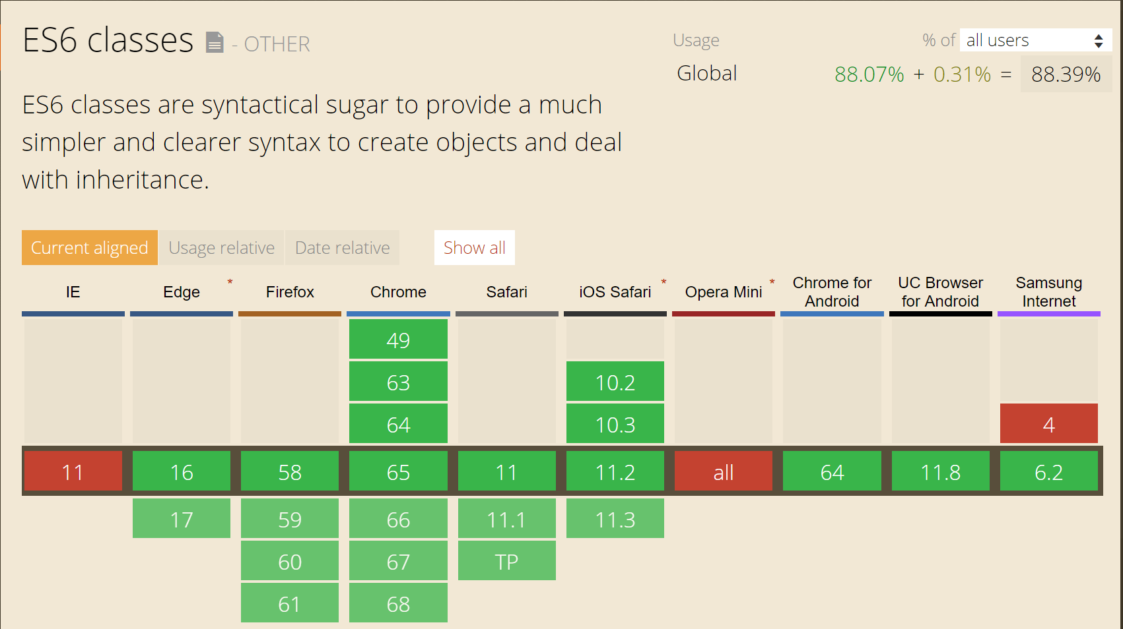
ES6 Adoption

Slide 12
ES6 Adoption (cont.)
Popular browsers of today is covering roughly 96% of the ES6 scope.
For a full compatibility table: https://kangax.github.io/compat-table/es6/

Slide 13
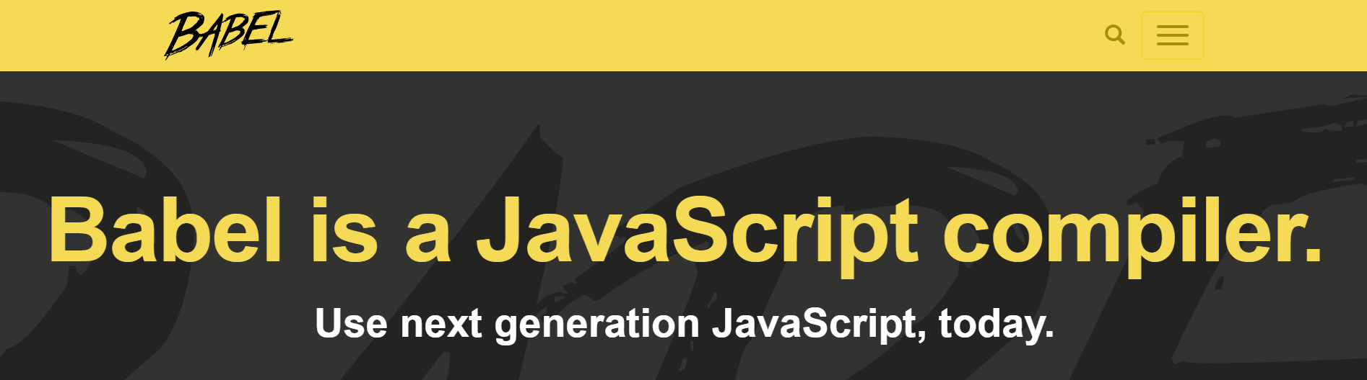
Using ES6 in an ES5 world
Even though there is a great adoption in the latest browsers, we as web developers must make our websites accessible from older browsers.
Either we refrain from using ES6 altogether
Or we use transpilers! ☺
Enter:

Slide 14
Babel - Usage
Command line: babel es6.js -o es5.js
Online: https://babeljs.io/repl
Installation docs: https://babeljs.io/docs/setup/

Slide 15
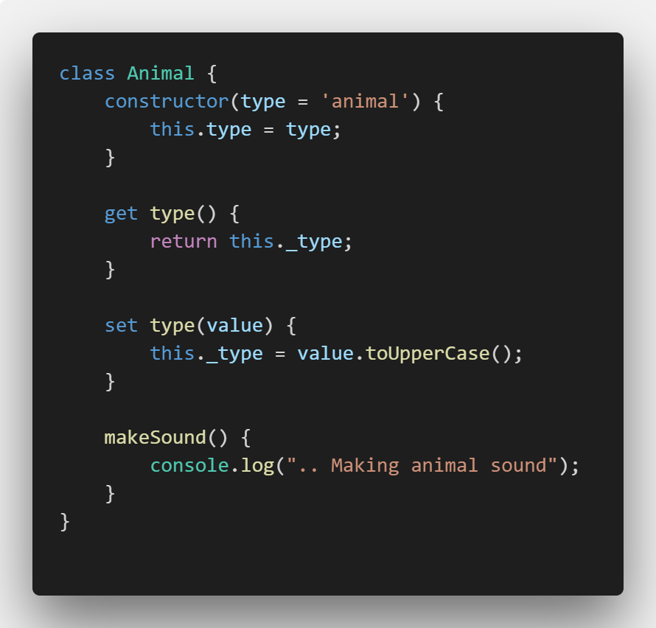
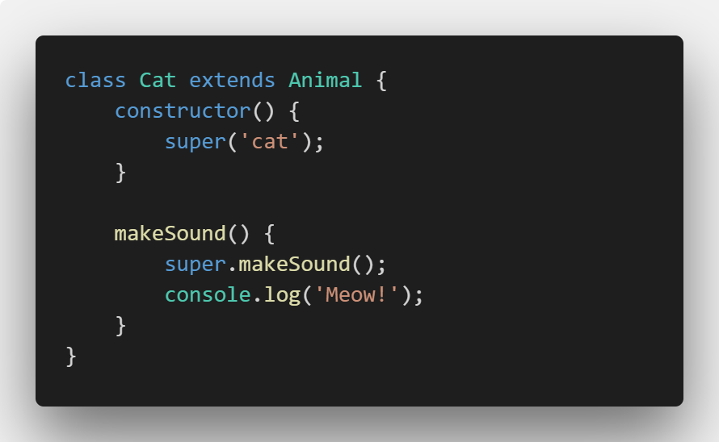
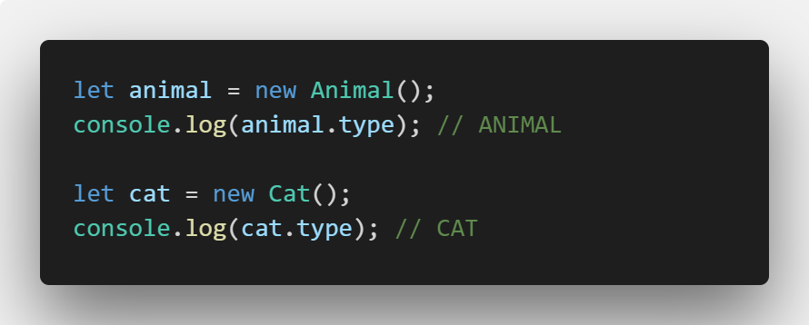
ES6 - Classes

Slide 16
ES6 – Setters and Getters

Slide 17
ES6 – Default parameters

Slide 18
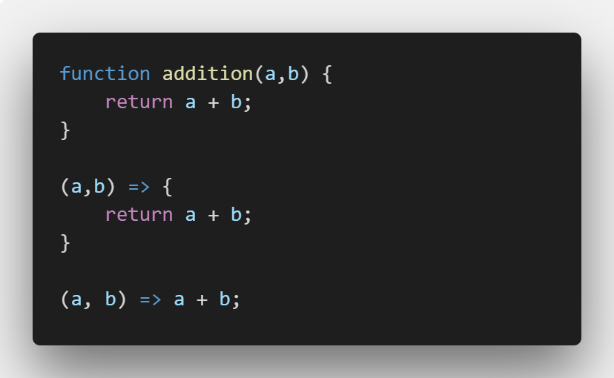
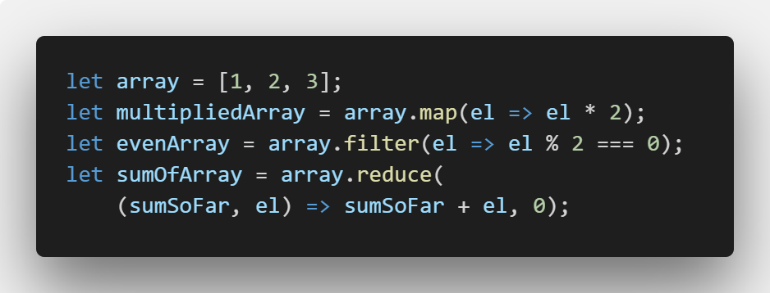
ES6 – Arrow functions
Examples:

Slide 19
ES6 – Async programming via Promise
A promise is an object, that holds the state of an async function
Can be waiting, resolved or rejected
Allows us to return a promise and work with that, even when the async function is not done.
Easier to read code
A Promise promises that it will be resolved
Uses observer pattern to populate the result

Slide 20
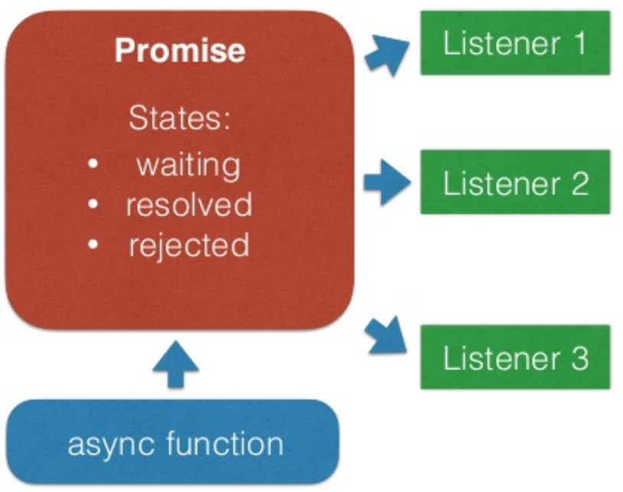
ES6 – Promise

Slide 21
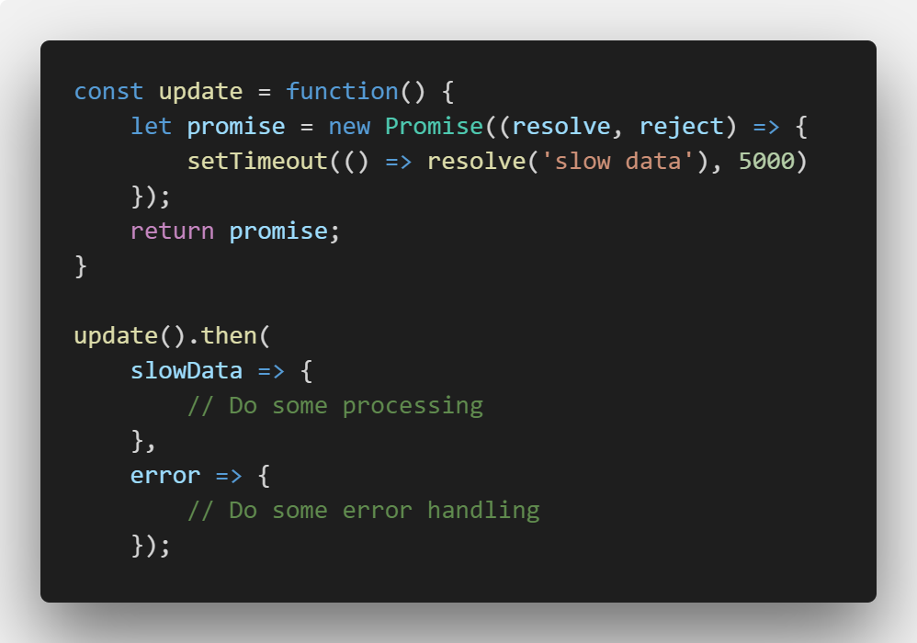
ES6 – Promise (cont.)

Slide 22
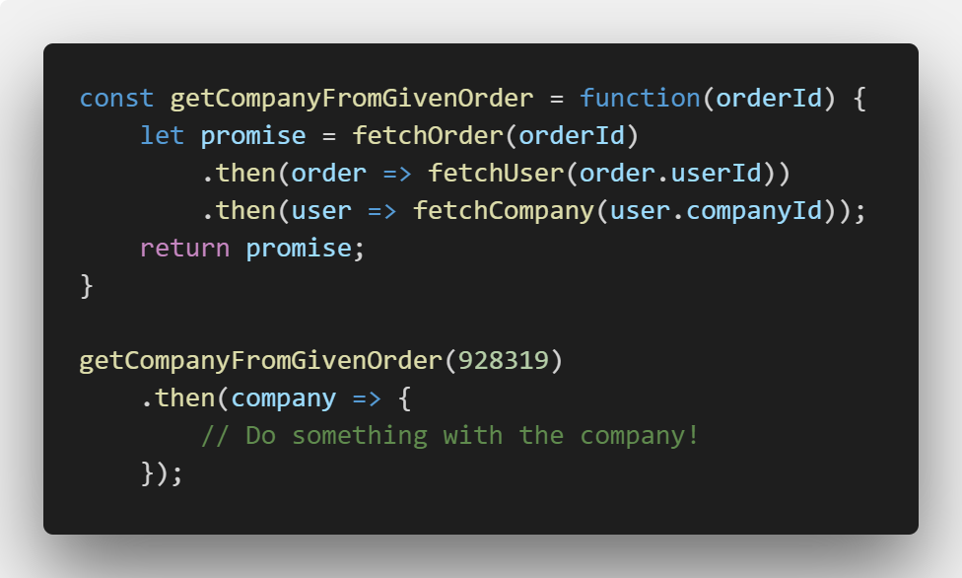
ES6 – Promise chaining

Slide 23
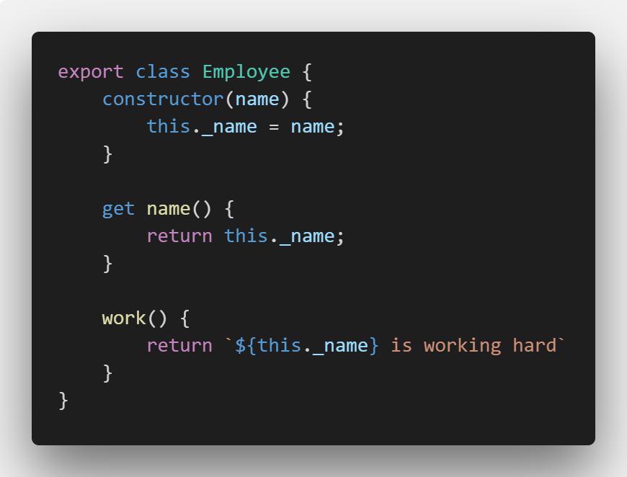
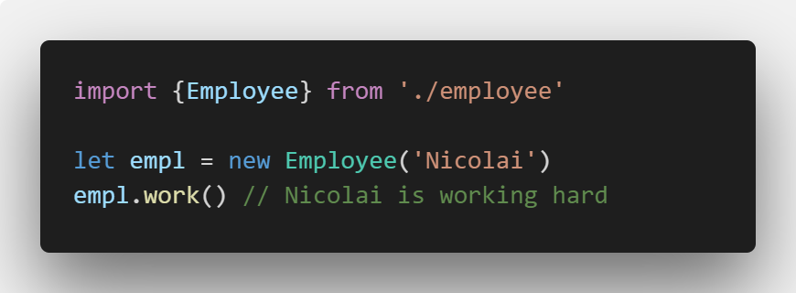
ES6 - Modules
Native ES6 modules are not yet implemented
Use tools such as Browserify and Webpack

Slide 24

JavaScript Frameworks

Slide 25
Frameworks in the stack
Web Application
JavaScript Frameworks
Core JavaScript
Web Browser

Slide 26
Advantages
Seamlessly handled cross browser issues
Help speed up development
Easy to learn and use
Serves as a base for development of further libraries and frameworks

Slide 27

A few frameworks

Slide 28
The choice
There are a lot of options when dealing with JavaScript Frameworks
This abundance of choices leads to confusion.
How do you pick the right library or framework?

Slide 29
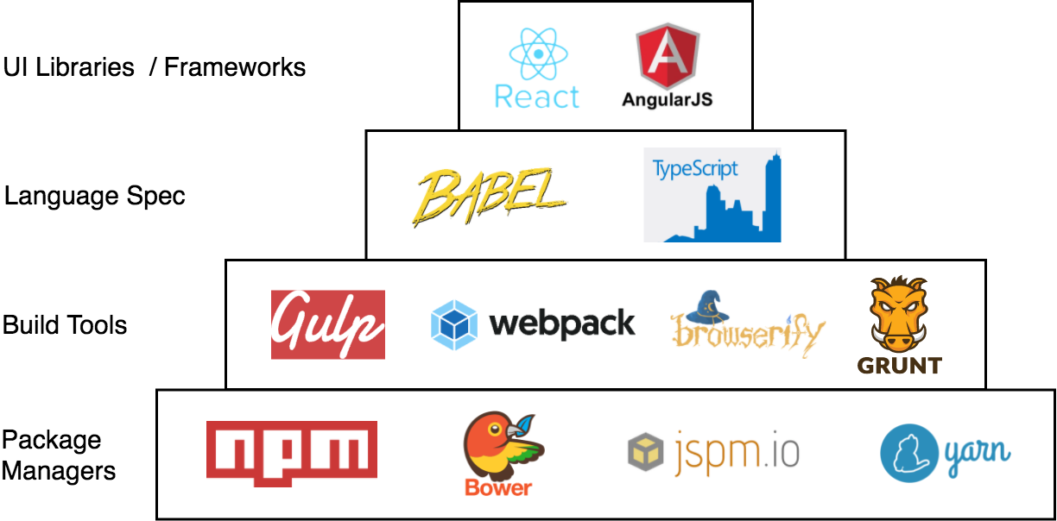
The front-end stack

Slide 30

Core JavaScript engine
Every major browser vendor provides their own JavaScript engine
Varying degree of JavaScript support by different engines
Major engines:
Chakra
V8
SpiderMonkey

Slide 31


DOM Libraries
jQuery
Mootools
etc

Slide 32





Web App libraries
Backbone JS
Ember
Angular
React JS
Vue JS

Slide 33
jQuery introduction

Slide 34
What is jQuery
Cross platform javascript library
Designed to simplify client side scripting
It is open source
It is the most widely deployed Javascript library (18.6% according to builtwith.com)
Intended to make navigating the DOM easier

Slide 35
Features
DOM element selections using Sizzle
DOM manipulation based on CSS selectors
Events
Effects and animations
Ajax
Deferred and Promise objects to control asynchronous processing
JSON parsing
Extensibility through plug-ins
Utilities, such as feature detection
Compatibility methods that are natively available in modern browsers, but need fall backs for older ones, such as inArray() and each()
Multi-browser (not to be confused with cross-browser) support

Slide 36
Browser support
jQuery 2.x → current version – 1, i.e. the current version and the version before.
jQuery 1.x → Internet Explorer 6 an above.

Slide 37
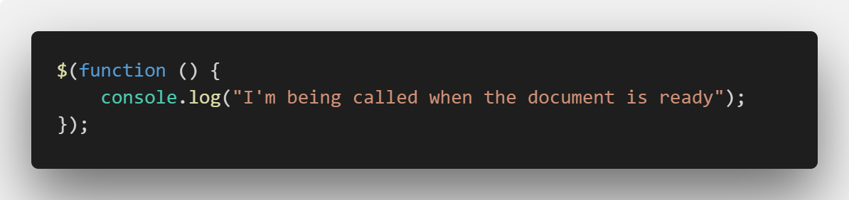
Example
Notes:
Runs on app startup

Slide 38
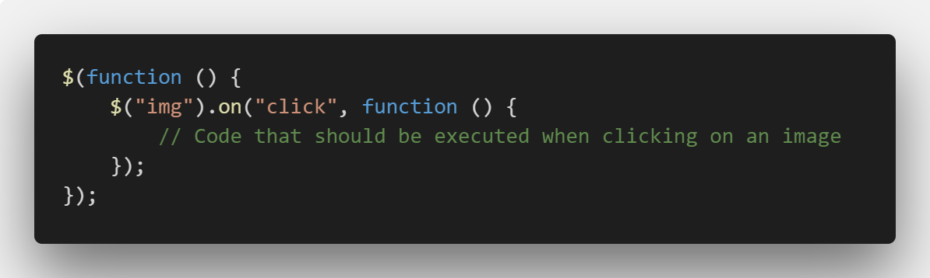
Events
Notes:
Selecting element with jquery uses CSS Selectors

Slide 39
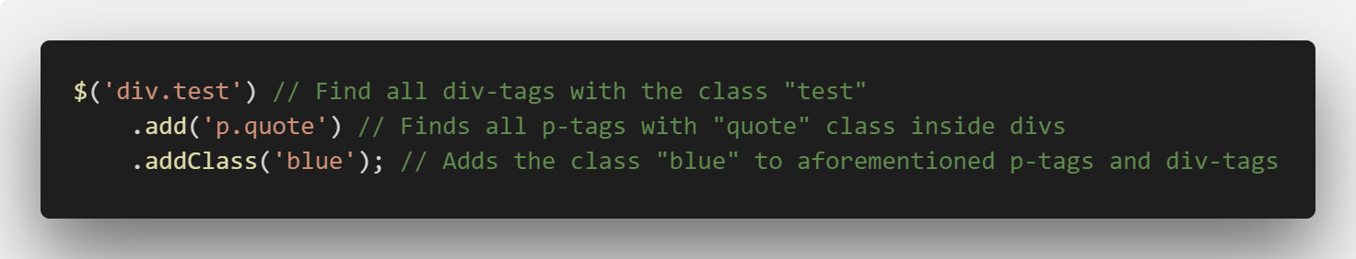
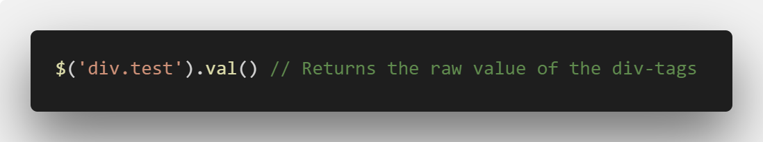
Chaining
Almost all jQuery functions return a jQuery object and therefore chaining is possible.
Some functions return a pure value:

Slide 40
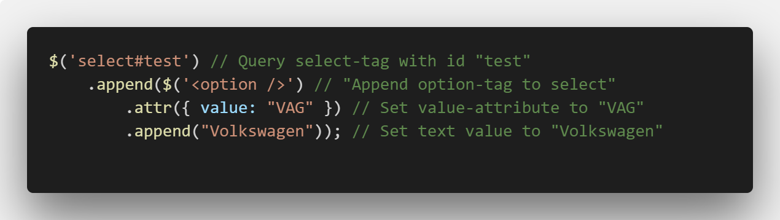
Manipulating the DOM

Slide 41
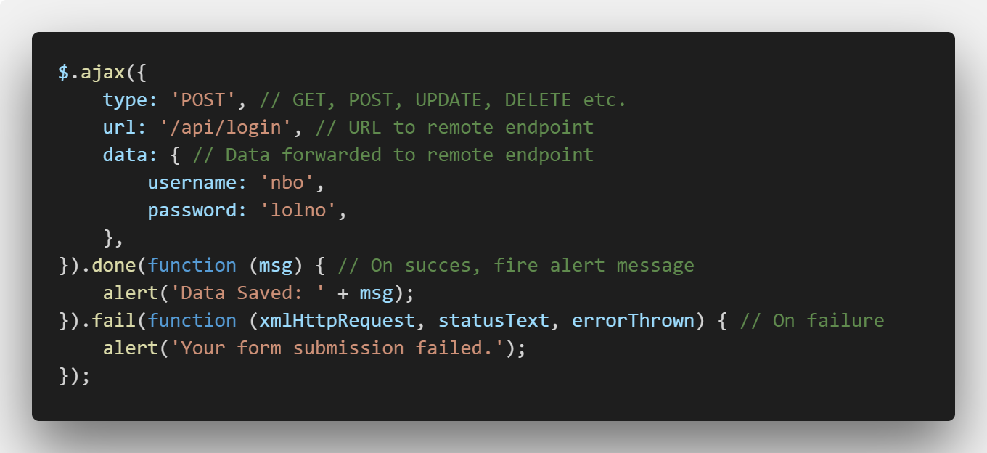
AJAX

Slide 42
Exercise
Go to https://codepen.io/NicolaiOksen/pen/mxOePN
Click on Fork (top right corner)
Create an event handler for click, mouseenter and mouseleave
What happens is up to you to decide
Try selecting different elements
Try manipulation the DOM with jQuery
20 minutes

Slide 43

React JS An introduction

Slide 44
What is React
Javascript library for building user interfaces
Open source
Developed and maintained by Facebook and individual developers
Used on many different sites:
Netflix, Imgur, Bleacher Report, Feedly, Airbnb, SeatGeek, HelloSign, Walmart

Slide 45
Features
Component based
One way data flow
Properties are immutable
"properties flow down; actions flow up"
Virtual DOM
In memory copy of the DOM
Allows React to find differences and update only required bits.
Much faster and efficient than jQuery
JSX
More later
Architecture beyond HTML
React Native
Using React to develop native applications for iOS, Android and UWP

Slide 46
Browser support
Supports all major browser
From Internet Explorer 9 and above
Requires ECMAScript 5 support
Works best with a proper build line and ES6

Slide 47
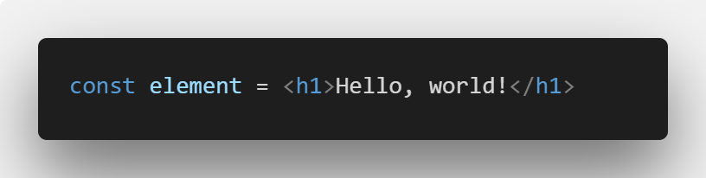
JSX
An extension to Javascript
Allows using HTML-like markup in Javascript to create components
Example:

Slide 48
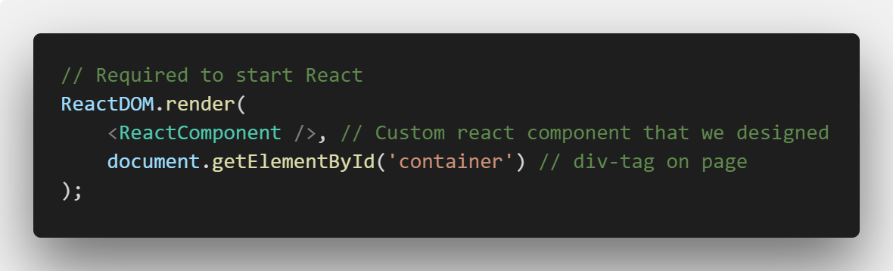
Using React

Slide 49
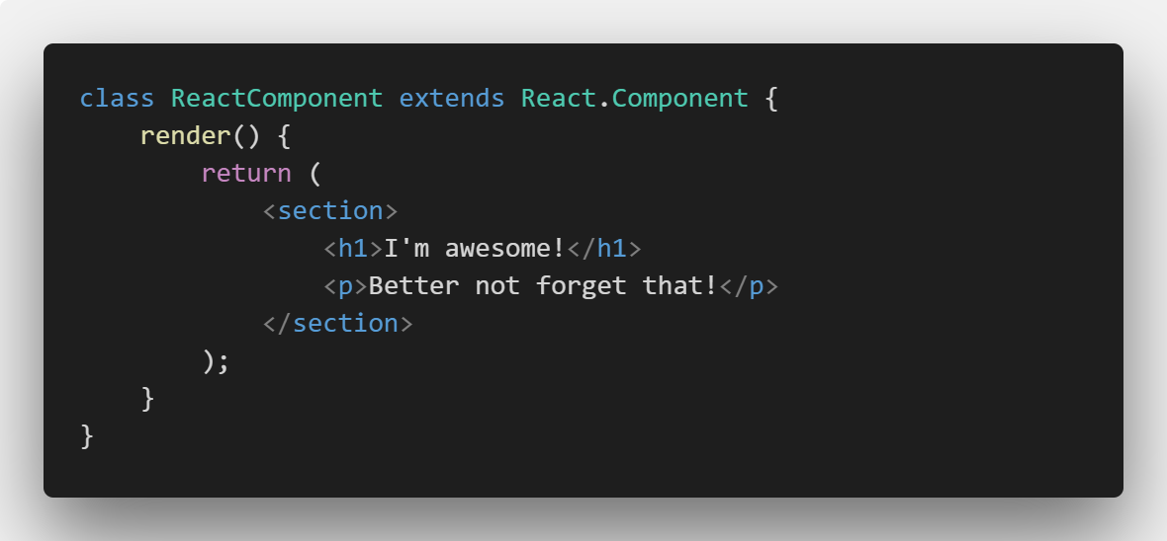
A Component in React
Notes:
Reusable component which inserts a section, with an H1 and a P tag.

Slide 50
JSX is complex
React and JSX can be quite hard to grasp
Best way to learn is ”by doing”
Codecademy has a course on React

Slide 51

Vue JS An Introduction

Slide 52
What is Vue JS
Open source
Progressive JavaScript Framework for building user interfaces
Component oriented

Slide 53
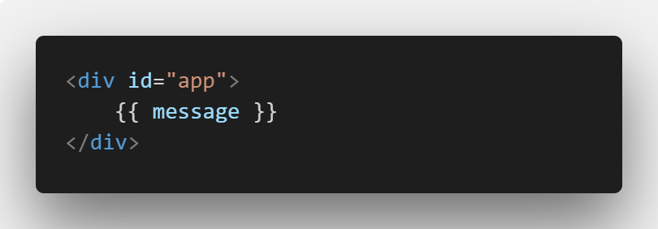
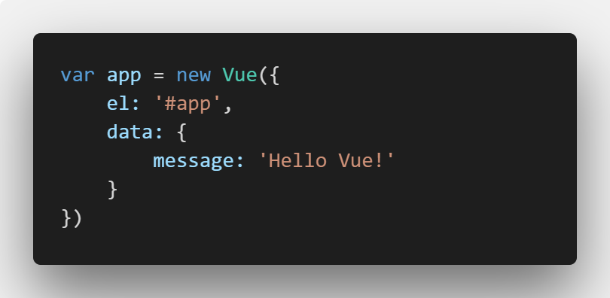
Declarative Rendering
At the core of Vue.js is a system that enables us to declaratively render data to the DOM using straightforward template syntax:

Slide 54
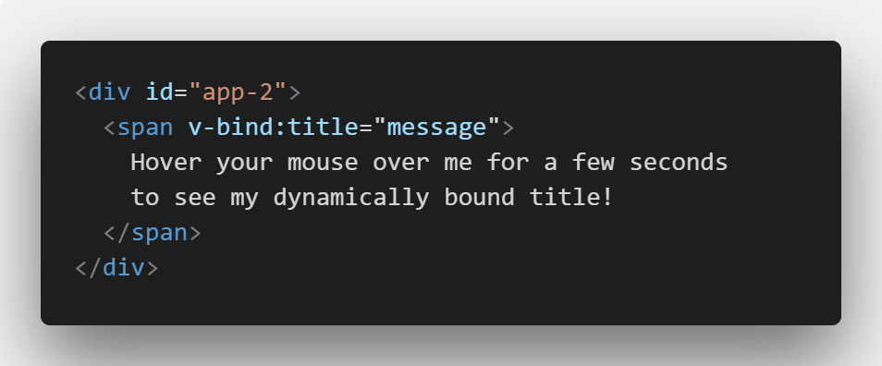
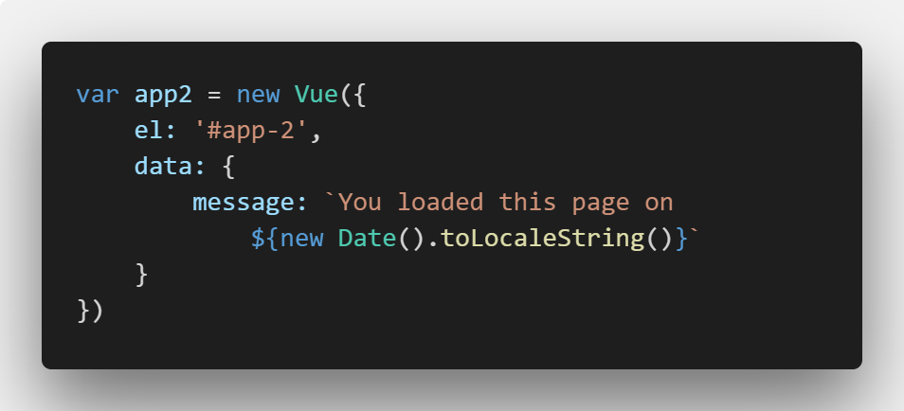
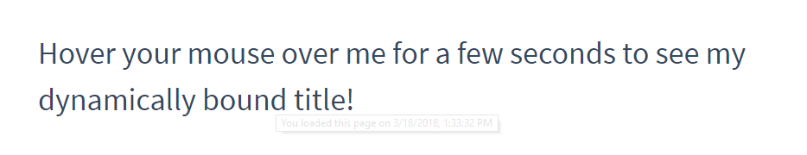
Binding attributes
With vue we can also populate attributes dynamically with some Vue magic
v-bind is a directive.

Slide 55
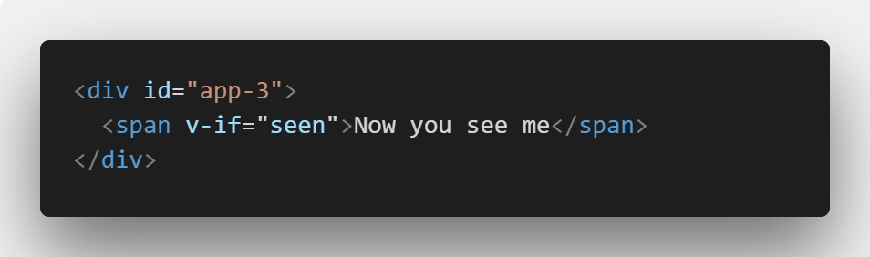
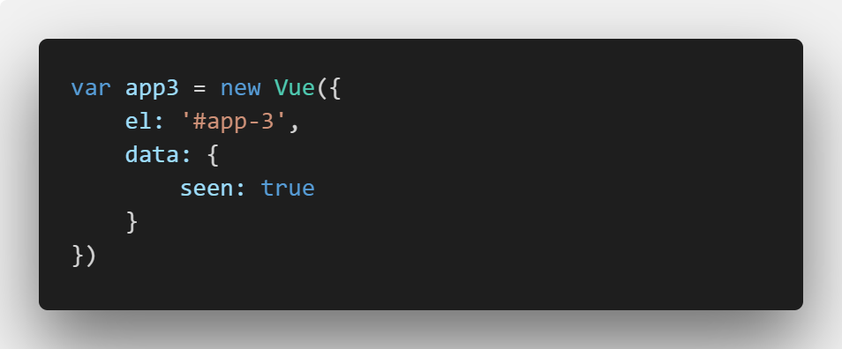
Conditionals
Using conditionals it is easy to toggle the presence of a given element.
By going to your browsers console you can change the visibility:
app3.seen = false

Slide 56
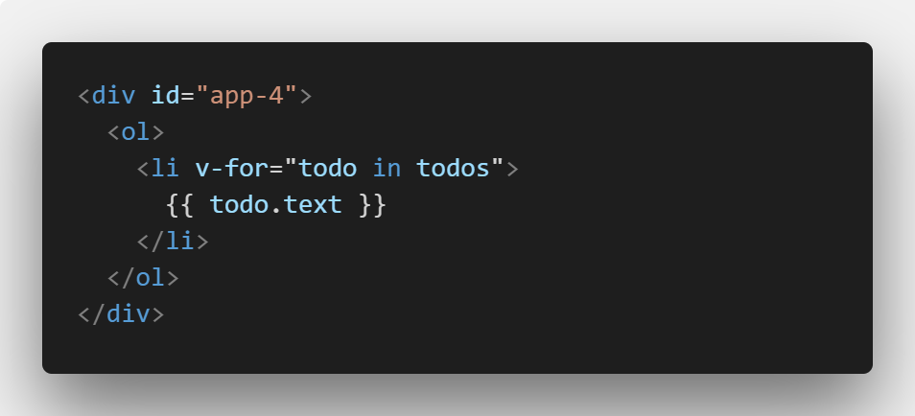
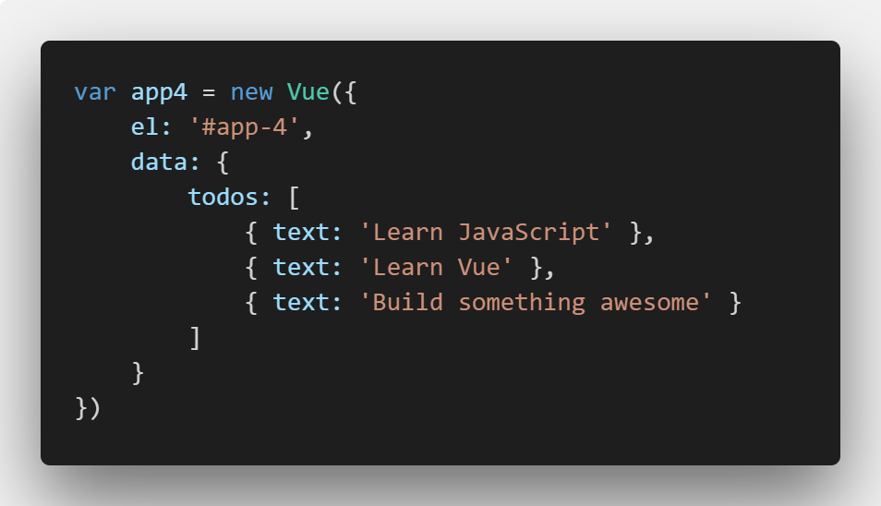
Loops
v-for is another directive, allowing use to loops over arrays and create multiple elements.
Result:
Learn JavaScript
Learn Vue
Build something awesome
In the console, try: app4.todos.push({ text: 'New item' })

Slide 57
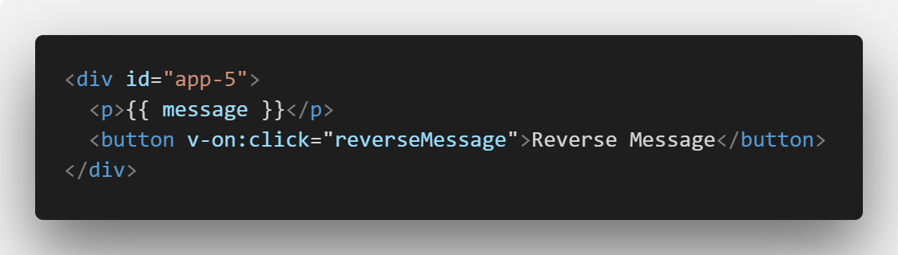
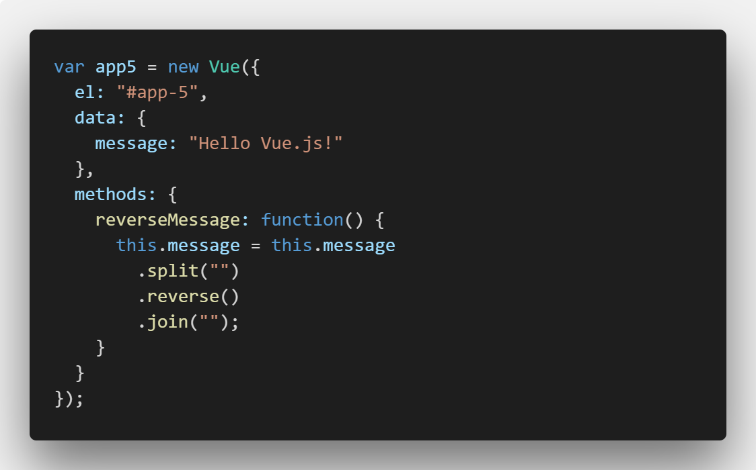
Events
To let users interact with your app, we can use the v-on directive to attach event listeners that invoke methods on our Vue instances.
Manipulating the DOM, is all handled by Vue.
This lets us focus on code logic not the DOM

Slide 58
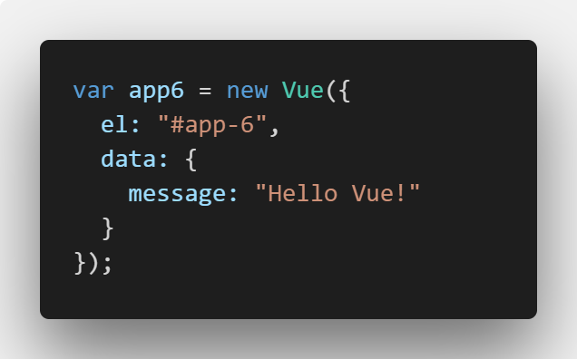
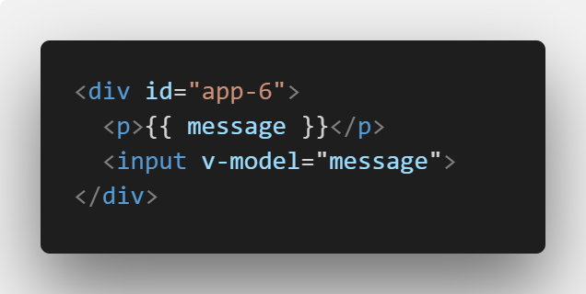
Two-way binding
By using v-model we allow our web app to use two way binding.
Try it out: https://codepen.io/NicolaiOksen/pen/bvBVXr

Slide 59
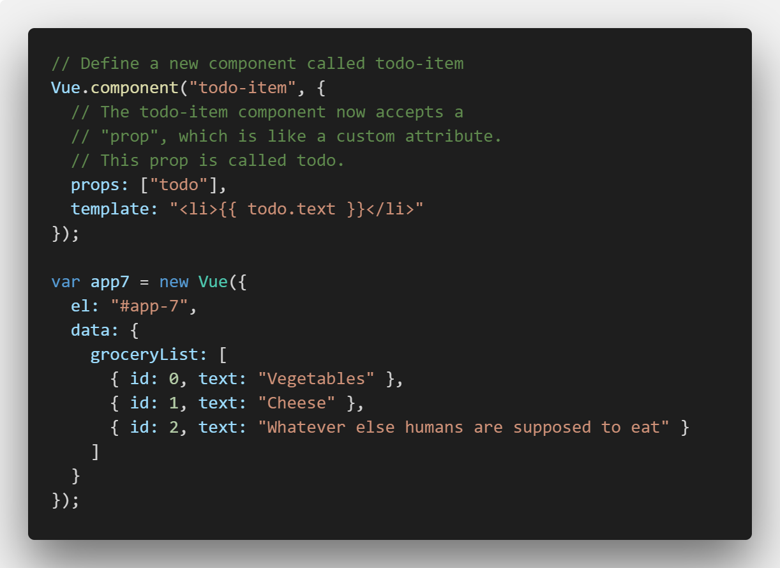
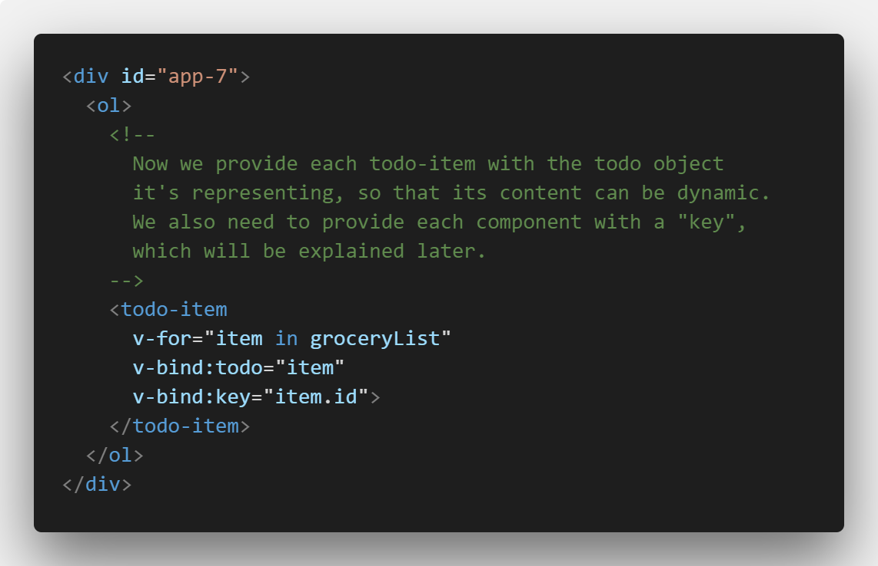
Components
A component is a small, self-contained and reusable piece of code.

Slide 60
Exercise
Go to https://codepen.io/NicolaiOksen/pen/KoNdoX
Click on Fork (top right corner)
Change HTML to get data from Vue
Make an click event and change the background color of something
20 minutes

Slide 61

Web Assembly

Slide 62
What’s next?
As mentioned earlier, JavaScript is the only native language of browsers
That is not entirely true today…
Web Assembly is a way to compile a language to bytecode and execute directly in the browser

Slide 63
What is Web Assembly
Denoted as WASM
It is supported by roughly 72% of all global browser
An improvement to JavaScript:
Implement your performance critical stuff in WASM and import it like a standard JavaScript module.
A new language:
WebAssembly code defines an AST (Abstract Syntax Tree) represented in a binary format. You can author and debug in a text format so it’s readable.
A browser improvement:
Browsers will understand the binary format, which means we’ll be able to compile binary bundles that compress smaller than the text JavaScript we use today. Smaller payloads mean faster delivery. Depending on compile-time optimization opportunities, WebAssembly bundles may run faster than JavaScript, too!
A Compile Target:
A way for other languages to get first-class binary support across the entire web platform stack.

Slide 64
What will it be used for?
Threaded operations
Single Instruction Multiple Data – SIMD
In essence, parallel operations
WebAssembly fills in the gaps that would be awkward to fill with JavaScript.

Slide 65
A bit of history
June 2015 – WebAssembly was announced
March 2016 – Google, Microsoft and Mozilla preview WASM in their browsers
October 2016 – WebAssemly becomes a binary release candidate
March 2017 – Begins to be shipped on-by-default in major browsers

Slide 66
To binary
WebAssembly compiles into a Abstract Syntax Tree (AST)
In a compiler the AST keeps source location information and some typing information
WebAssembly gets compiled to binary AST from languages like Haskell, C++ or C

Slide 67
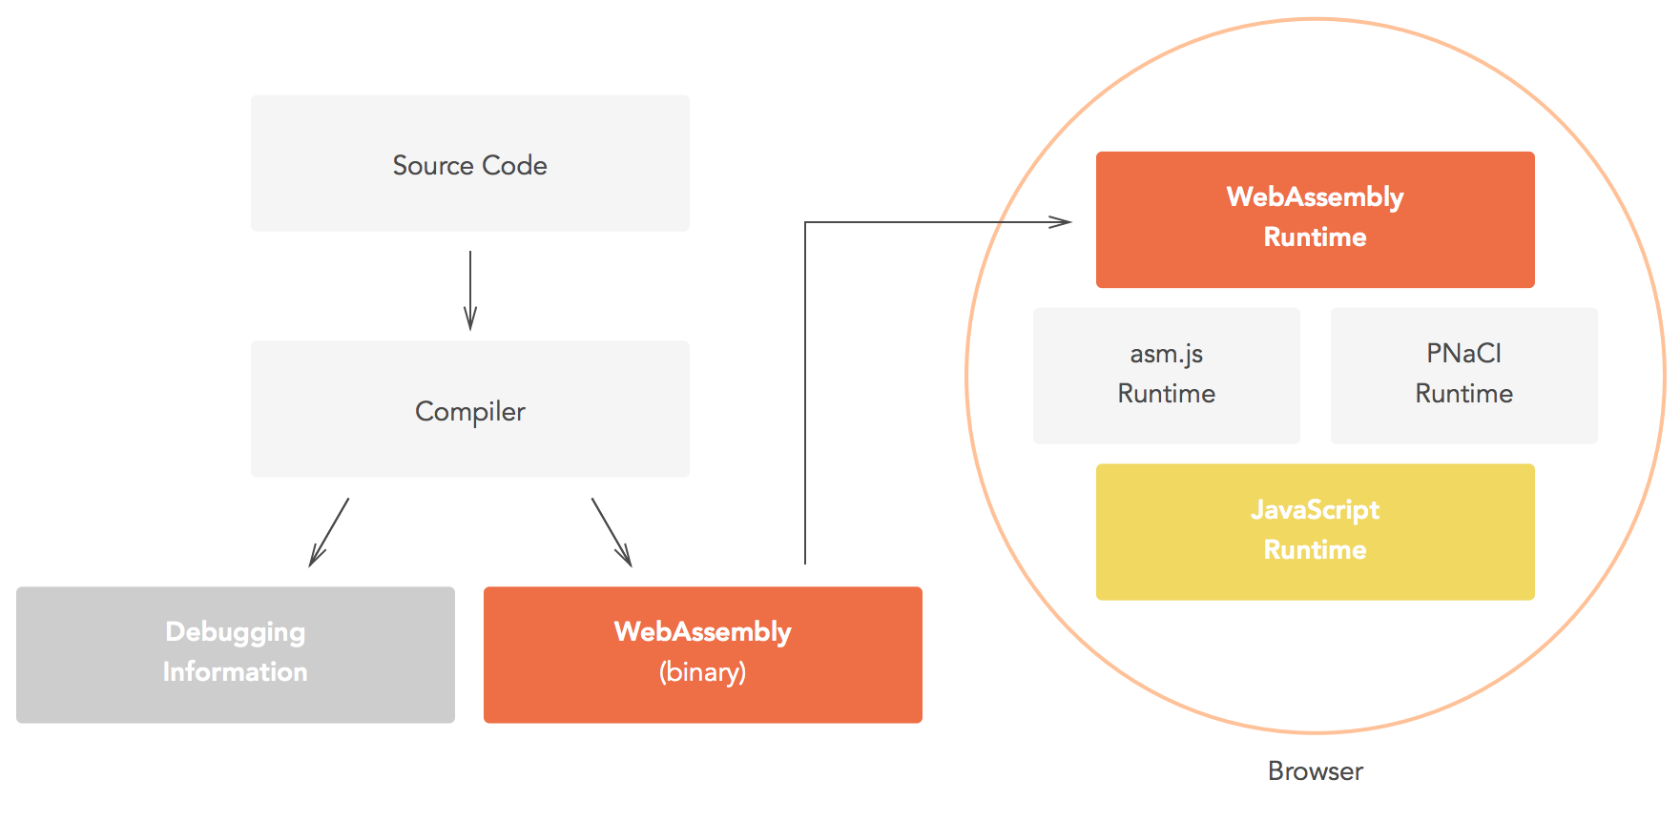
To binary… (cont.)

Slide 68
Advantages
You’re able to use other languages then JavaScript in the browser
In WASM you can author and debug in a text format, thereby it is readable
We talking about a new low-level language in the spirit of Assembler

Slide 69
Now you ask… Doesn’t ASM.js do this?
Well, no…
ASM.js is a low-level subset of JavaScript
It appears to have direct memory register access, but it is still parsed by JavaScript
Therefore you still have the overhead of JavaScript
WebAssembly is bypassing this by directly using the AST in a binary format (yay!)

Slide 70
The bottleneck that is JavaScript
JavaScript is restricted in its flexibility
WebAssembly works at the “bare metal” memory layer in the browser
WebAssembly is filling the holes left by JavaScript, in terms of controlling bit/byte level memory register control
JavaScript simply cannot get to that low-level.
But the awesome part… You are able to compile other languages for the browser!

Slide 71
JavaScript out, WebAssembly in?
WebAssembly is not a repleacement for JavaScript
JavaScript is still needed for accessing the DOM
They are to be used in collaboration with eachother

Slide 72
WebAssembly and C#
So, is it possible to use C# in the browser?
Yes it is! It is called Blazor! Take a look here: https://github.com/aspnet/blazor

Slide 73
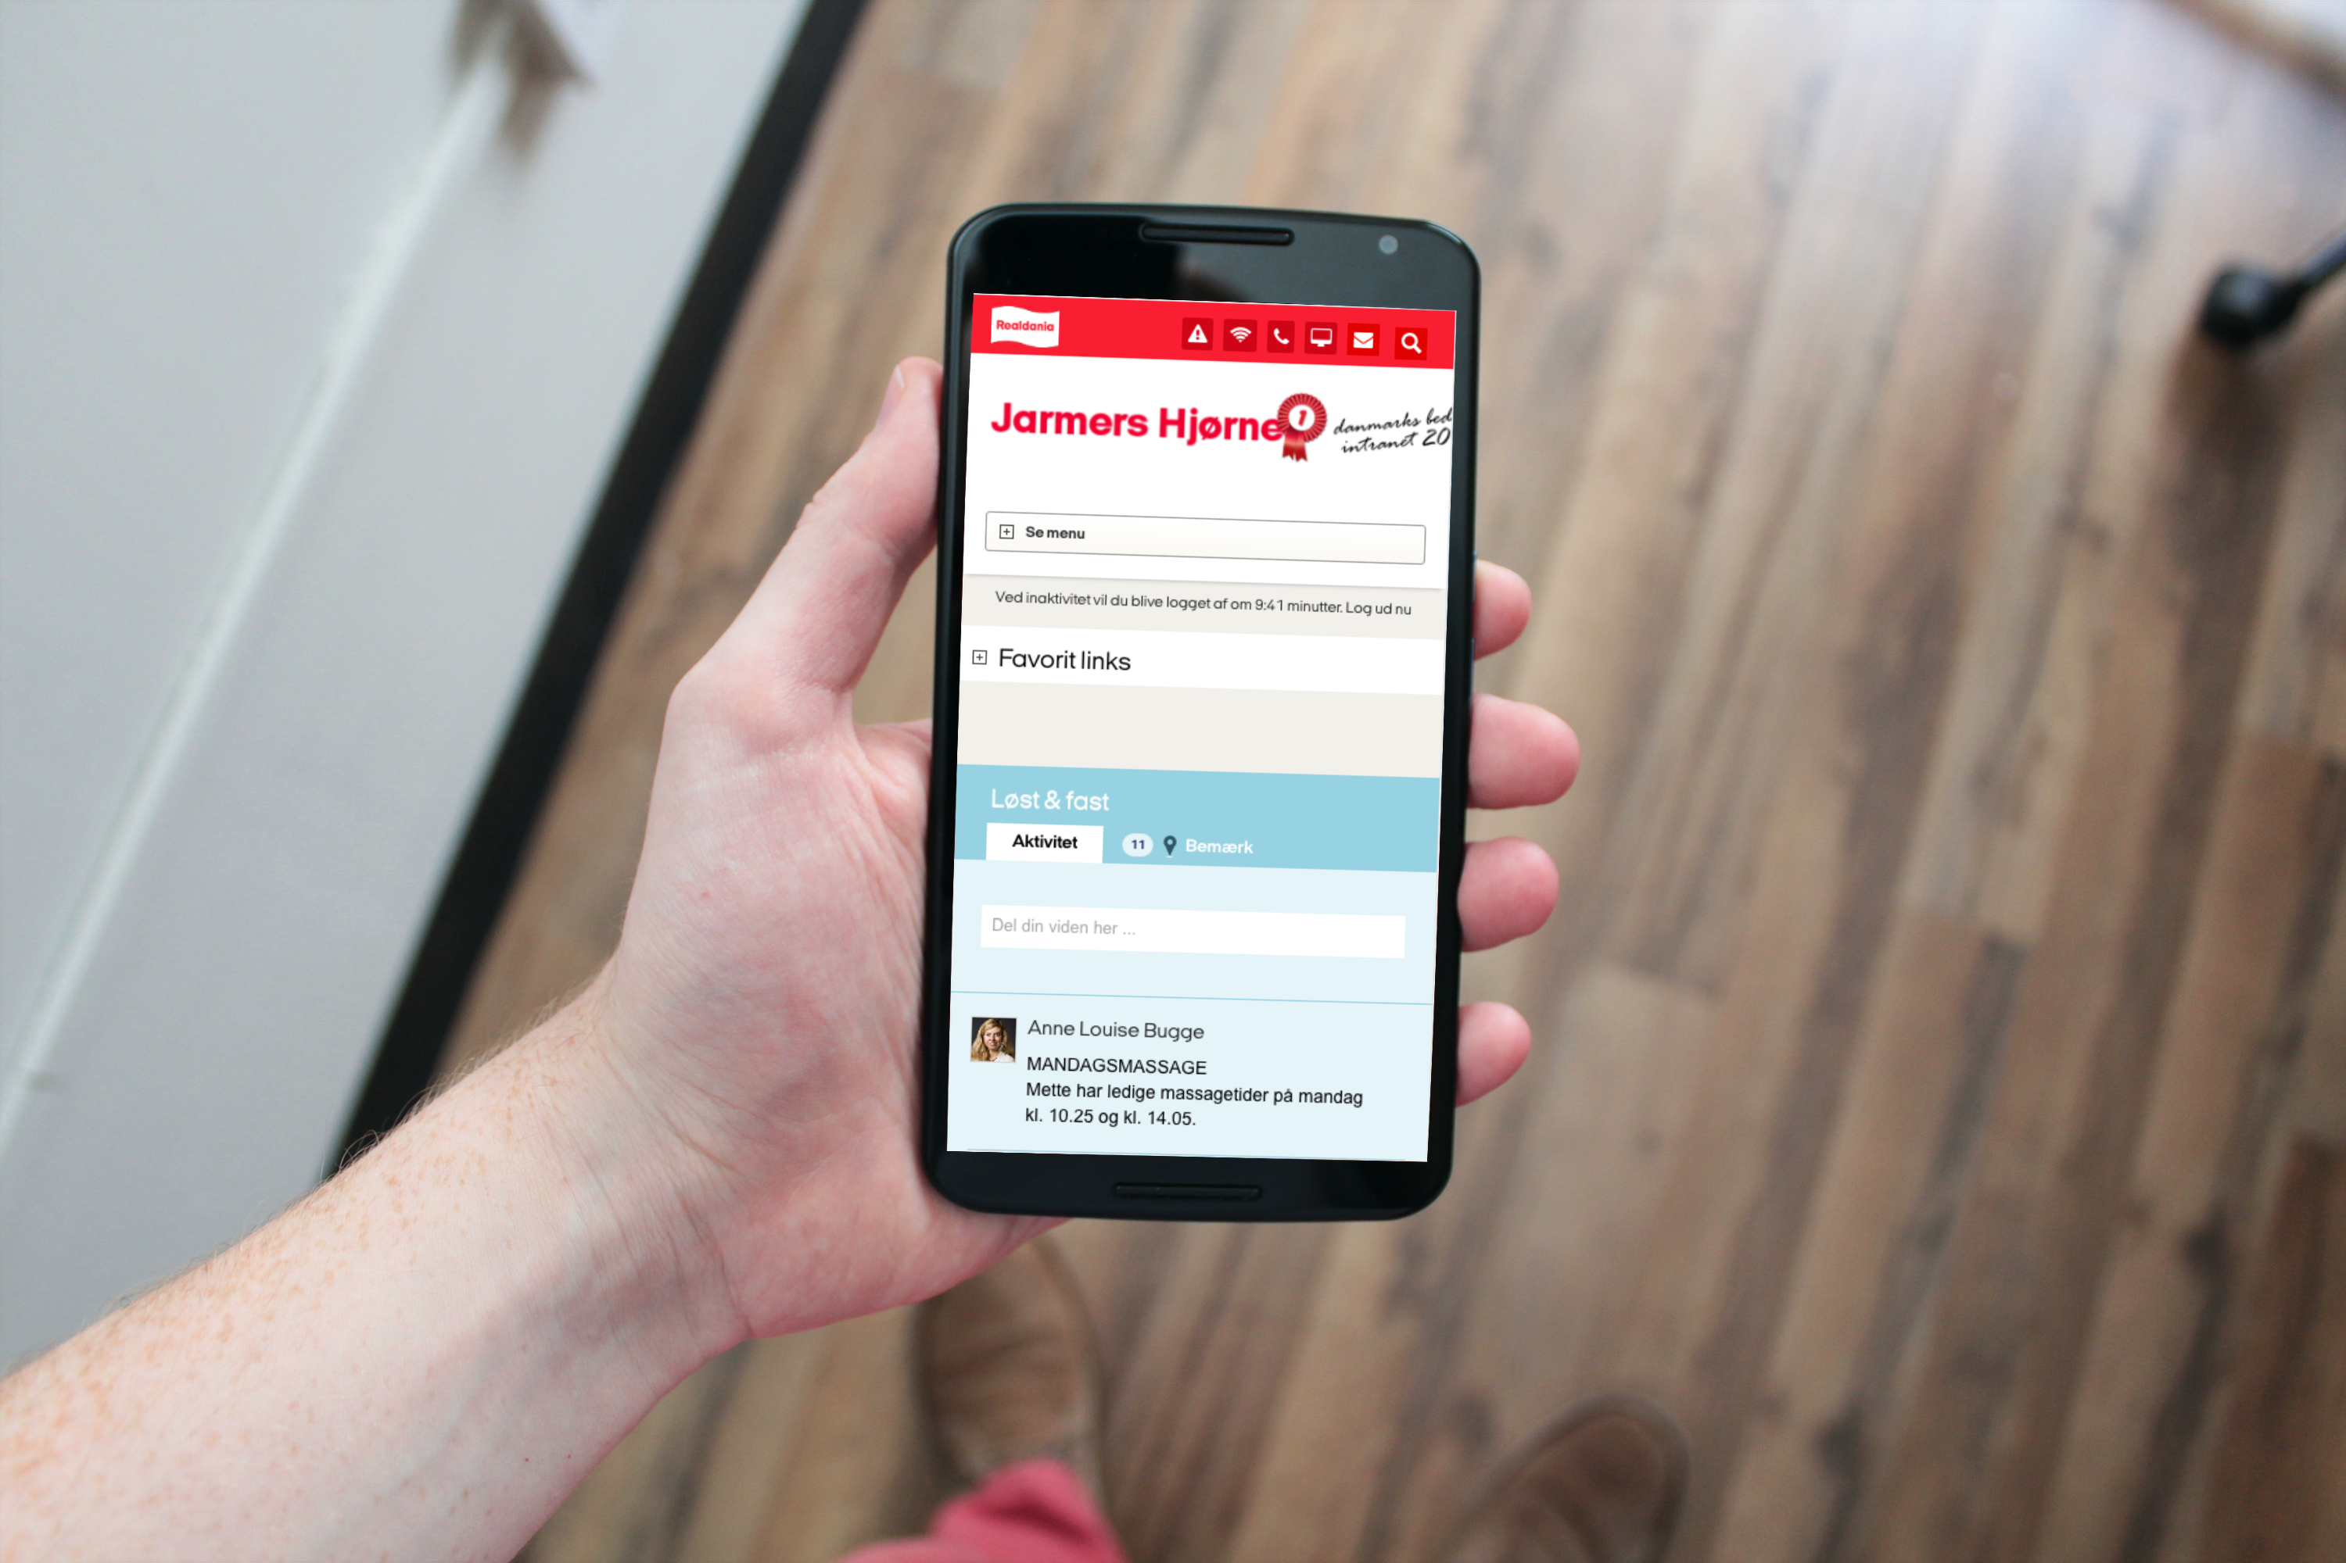
Questions?

Slide 74

Brugbare elementer
Dobbeltklik for at ændre farve eller indsætte baggrundsbillede

